Slide 1

Technical Writing
Letter Writing
Semester 3 – Professional Communication Skills (303193203)

Slide 2
Learning Objectives
Understand the structure and format of professional emails and letters.
Apply email etiquette in various communication scenarios.
Draft formal and informal emails using appropriate tone and structure.
Compose business letters such as inquiries, replies, and complaints.
Improve clarity, conciseness, and professionalism in written communication.

Slide 3
Introduction
Letters are formal tools of written communication in academic, professional, and business contexts.
Understanding correct formats and etiquette is essential.
Letters convey important messages and require clarity, tone, and structure.

Slide 4
Importance of Letter Writing
Builds professional image:Formal communication shows that you are serious, respectful, and professional, helping to create a positive impression.
Used in job applications, inquiries, complaints, and official replies:It is essential for communicating in formal situations like applying for jobs, asking for information, making complaints, or responding officially.
Provides a record of communication:It keeps a written record that can be referred to later for clarity, proof, or follow-up.

Slide 5
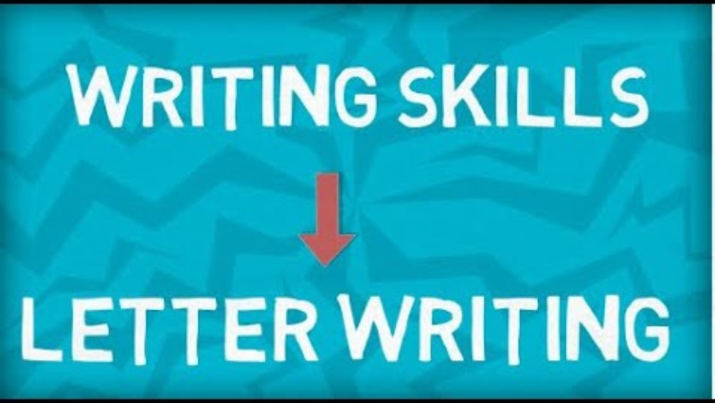
Types of Letters
Inquiry Letter: Requesting information
Complaint Letter: Highlighting an issue
Reply Letter: Responding to inquiries or complaints
Application Letter: Job or internship applications

Slide 6
Structure of a Formal Letter
Sender’s Address
Date
Receiver’s Designation & Address
Subject Line
Salutation (e.g., Respected Sir/Madam)
Body (Intro, Details, Conclusion)
Complimentary Close (e.g., Yours sincerely)
Signature and Name

Slide 7
Mnemonic for Letter Format – SODARC
Letter | Meaning | Description
S | Sender’s Address | Top left corner of the letter
O | Opening Date | Leave a line after address, write date
D | Designation/Receiver | Mention designation if known
A | Address of Receiver | Full postal address
R | Respected Salutation | Respected Sir/Madam
C | Content & Closing | Body (3 parts) and formal closing

Slide 8
Sample – Inquiry Letter
Topic: Requesting course brochure from an institution
Sender’s info
Subject line: Inquiry Regarding Postgraduate Course Brochure
Three-paragraph body: Intro, Request details, Thank you note

Slide 9
Sample – Complaint Letter
Topic: Complaint about defective product
Formal tone
Facts: Product details, issue experienced, expected resolution
Polite yet firm language

Slide 10
Sample – Reply Letter
Topic: Response to an inquiry about hostel accommodation
Acknowledge the inquiry
Provide clear and structured response
Include contact or follow-up details

Slide 11
Letter Writing Etiquette – Dos
Use polite and respectful language: Maintain a courteous tone to show professionalism and respect.
Keep the content clear and concise: Write simply and directly to ensure easy understanding.
Proofread for grammar and structure: Check for errors to keep the message correct and professional.
Maintain logical flow (intro–body–conclusion):Organize ideas clearly for smooth and effective communication.

Slide 12
Letter Writing Etiquette – Don’ts
Don’t use contractions or informal words: Use full forms and formal vocabulary to maintain a professional tone.
Avoid spelling errors and poor formatting:Ensure correct spelling and proper layout for clarity and a polished appearance.
Don’t be emotional or aggressive:Keep your tone calm and respectful, even when expressing concerns or disagreements.
Avoid vague subject lines or unstructured content:Use clear subject lines and organize your content logically to make your message easy to understand.

Slide 13
Activity 1 -Letter Correction Challenge
Instructions:
Give students a sample formal letter with intentional mistakes in tone, format, grammar, and structure.
Ask them to work in pairs or small groups to identify and correct the issues.
After 10–15 minutes, discuss the corrected versions as a class, highlighting key points on etiquette, clarity, and structure.

Slide 14
Activity 2 -Write and Swap – Purpose-Based Letter Writing
Instructions:
Assign each student or pair a different letter type (e.g., job application, inquiry, complaint, request for information, response to an official letter).
Have them write a formal letter using the correct format (sender's address, date, salutation, body, closing, signature).
Once complete, they swap letters with another pair for peer review, focusing on tone, clarity, structure, and etiquette.
Optionally, a few letters can be read aloud and discussed in class.

Slide 15
Conclusion
Recap of key points:
Emails and letters are structured forms of written communication.
Follow proper etiquette and use clear, concise language.
Formal and informal formats differ in tone and content.
Use mnemonics like SODARC to remember structure easily.

Slide 16
Learning Outcomes
By the end of this two-hour session, students will be able to:
Understand the importance of formal letters in academic, professional, and business contexts.
Recognize and apply correct formats, tone, and etiquette in formal letter writing.
Draft clear and well-structured formal letters for various professional purposes.
Identify common mistakes and improve written communication through peer feedback and self-correction.

Slide 17
Thank You

